Slide 1
Cost of Living Crisis in York: understanding and reducing health impacts
Thursday 30 November 2023
12:30 – 1:30pm

Slide 2
Agenda Welcome and introduction to Population Health Hub (PHH): Peter Roderick - (5mins) 2. Healthwatch - people experiences of cost of living rises in York Siân Balsom - (10mins) 3. Overview of the cost of living pack - Heather Baker (15mins) 4. Health data on physical, mental health and respiratory conditions Tom Dolman, George Scott (15 mins) 5. Questions - (15 mins) PLEASE CAN YOU REMAIN ON MUTE UNTIL THE QUESTIONS SECTION – THANK YOU

Slide 3
Cost of Living survey results
28 November 2023
Siân Balsom

Slide 4
Our Cost of Living work
2 surveys. First Oct-Dec 2022, second Feb-Mar 2023.
200 respondents to each
Additional questions in the second to quantify impact on mental health
Notes:
We heard from 200 people from across York between October and December about the impact of the cost of living rises on them. We repeated the survey in February and March and published the resulting report in May this year. We found people were no longer able to afford nutritious food, heating and non-essential items which was causing isolation, worsening physical health conditions and feelings of anxiety, depression and shame. Our findings helped to inform cross sector work on the issue.
We hope this work contributes to the national debate about what people need to live rather than just survive, and what a minimum income standard looks like in 2023 and beyond. We welcome the commitments made by local health and care partners to make sure we are alert to the realities of living without sufficient food and heating, without social opportunities and activities that sustain good mental wellbeing, and that we work together on minimising the impact of rising living costs on people in our city.

Slide 5
Key findings
The increasing cost of living is having a detrimental effect on York residents’ physical and mental health
York residents are deeply concerned about being able to keep themselves and their families warm
People are having to skip meals and/or relying on foodbanks - irrespective of what ward they live in
Residents are reducing their consumption of healthy foods due to rising costs
Notes:
These are the key findings of our second cost of living report, but the themes were reflected across both reports.

Slide 6
Key findings
Those whose answers indicate they are depressed and/or clinically anxious are disproportionately impacted
Rising costs are beginning to have an impact in households that had previously reported as managing
York residents are adapting by changing their spending and living habits, dipping into their savings, and increasing their borrowing
Feelings of isolation are increased by not being able to afford associated costs with socialising such as transport

Slide 7
Mental health has taken a huge nose dive. I’ve had a massive nervous breakdown this year as a result of home and work factors and pressures of being a one income household.
…the stress is starting to show physical signs like warts and eczema.
I am stressed all the time and feel constantly overwhelmed
Notes:
Wherever possible, we use people’s words directly in our reports. We believe in the power of people’s lived experiences.
So here’s what people told us…

Slide 8
I am disabled and reliant on benefits. Food, gas, electricity and petrol have all gone up so much. I already live as frugally as I can. My health issues mean that I can’t bear being cold without being in awful pain.
My meagre savings are disappearing with the rise in bills…
My circumstances right now are horrible and my already bad mental health has just got worse and worse to the point I’m self harming nearly every day

Slide 9
The rise has led to me eating non nutritious food. I am now contemplating coming off gluten free food so that I can buy cheaper alternatives although gluten food will make me incredibly unwell.
…Stress exacerbates my Crohn’s disease and has caused a flare of my symptoms.
I am refugee I came from Iran, I have no friends or family here life is very difficult for me.

Slide 10
I don’t heat water except for a weekly bath. I wash in cold. I don’t have the heating on, use blankets and a hot water bottle. I go to two food banks.
We have had to ration when we use heating. We have persistent black mould in the house which the landlord will not address and this has been exacerbated by not using the heating as much during the winter.
Not living just existing.

Slide 11
Some final statistics from our work
Over 55% reported health impacts, whether physical or mental health.
40% were unable to keep their homes as warm as they would like.
Over 40% skipped meals or reduced meal size.
36% were unable to afford healthy foods
People who had anxiety were 6.6 times more likely to be unable to eat when hungry than those who did not.
Notes:
People reported not being able to buy special foods, experiencing more colds and infections, having flare-ups of existing health conditions, increased stress and anxiety about how to manage, and increased household tensions and arguments as a result of needing to make financial decisions about how to survive.

Slide 12
Questions?
Notes:
But let’s turn to our strenghts. These are significants We are already here, being a local Healthwatch. We have our promotional materials, mental health guides, dementia guides, lots of ways for people to contact us, and a central office base in York.
Most of all though, we’re really well connected. We are part of over 40 different meetings and networks. We co-chair the Mental Health Coproduction Network and the York Multiple Complex Needs Network’s Creative Action Group, proactively demonstrating how to not just want different but be different. These networks are supporting key initiatives in the city like the Community Mental Health Transformation work, and putting what matters to people at the heart of those initiatives. We are always planning for the future, proactively moving ideas forward, centred and rooted in making change happen.
We value our partners and want to use our platform to amplify what they hear. We are now consolidating these partnerships into a Voice Network that will enable more people in York to be heard than ever before. The network has support from the York Health and Care Alliance and we intend it to also feed through to the Integrated Care System. The network will bring together people with lived experience, community representatives, frontline VCSE workers, and others, to hear about what is happening and share their feedback, helping to shape the future of our city.
Ends – flick to next slide – any questions?

Slide 13
For more information
Healthwatch York at York CVS Priory Street Centre
15 Priory Street, York, YO1 6ET www.healthwatchyork.co.uk
tel: 01904 621133
email: healthwatch@yorkcvs.org.uk
Tweet us @healthwatchyork
Facebook.com/HealthwatchYork
Notes:
Thank you!

Slide 14
Report on the Health Impacts of the Cost of Living Crisis
November 2023
“Skipping meals, turning heat off, not going out as much as [I] can’t afford bus fare, skipping prescriptions.”

Slide 15
Purpose of this Pack
The Population Health Hub (PHH) is a multi-organisation group which brings together colleagues from the local authority, health, public health, and business intelligence to enable, analyse and undertake population health management approaches in York.
In the context of growing winter pressures and the cost of living crisis, the PHH has created this pack to provide information about people in York whose health is likely to be affected by the cost of living crisis, who may be at risk of harm from winter and cold homes.

Slide 16
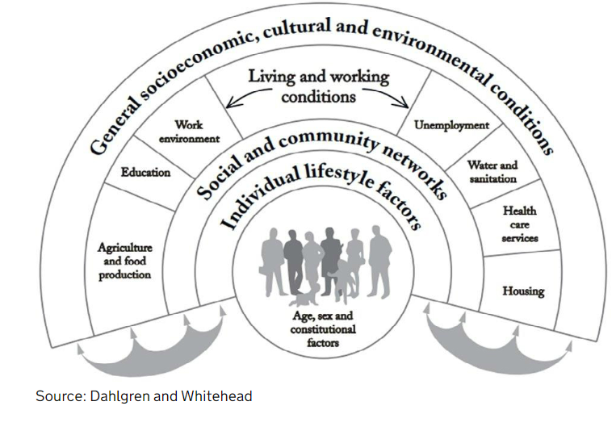
Overview of the Cost of Living Pack
In 2023, the London School of Economics declared the cost of living crisis as a public health emergency:
Some people are unable to afford even the basic essentials
Can have far-reaching short- and long-term- consequences on physical and mental health
As per the Wider Determinants of Health model- systemic and individual impacts are complex and intertwined

Slide 17
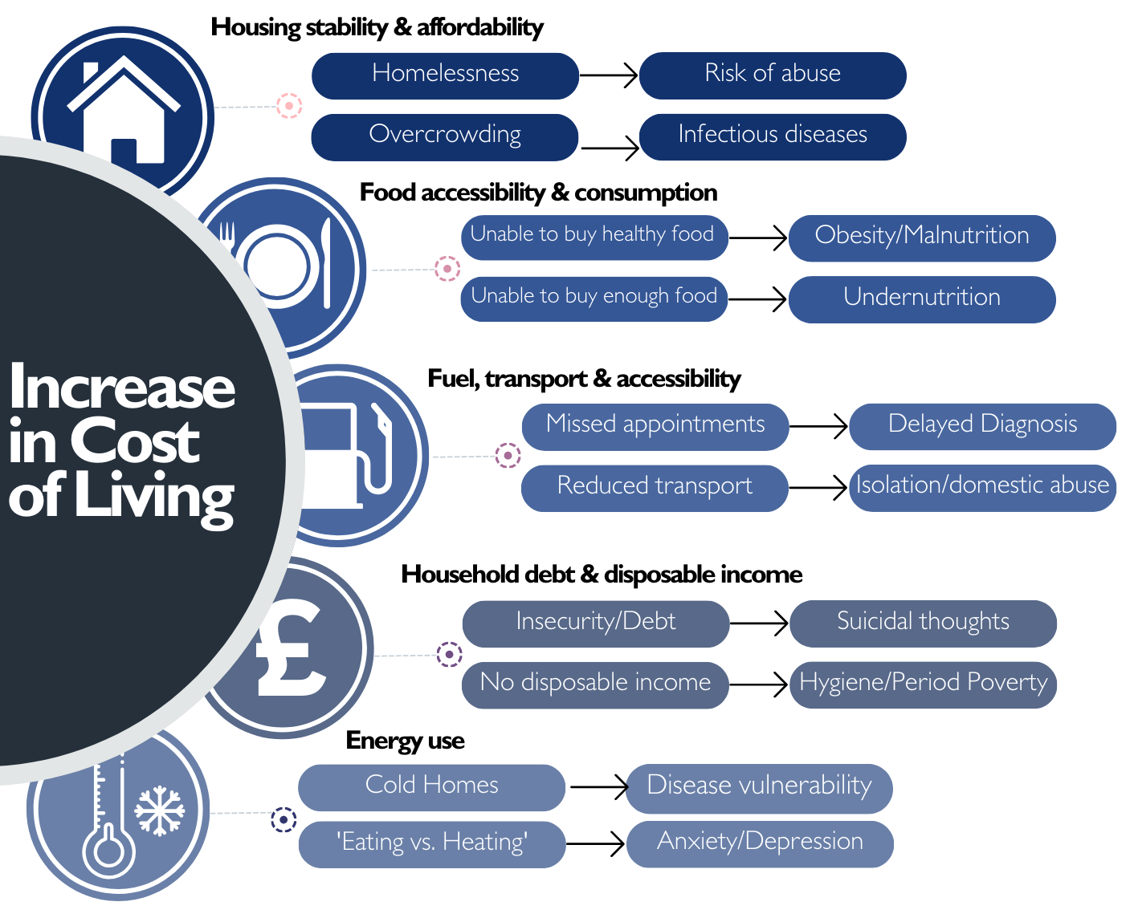
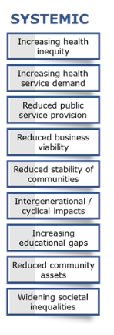
Overview of the Cost of Living Pack

Slide 18
Housing Stability & Affordability
Homelessness
Risk of abuse
Overcrowding
Infectious diseases

Slide 19
Food Accessibility & Consumption
Unable to buy healthy food
Obesity/malnutrition
Unable to buy enough food
Undernutrition

Slide 20
Transport & Accessibility
Missed appointments
Delayed diagnoses
Reduced transport
Isolation/domestic abuse

Slide 21
Household Debt & Disposable Income
Insecurity/debt
Suicidal thoughts
No disposable income
Hygiene/period poverty

Slide 22
Energy Use
Cold homes
Disease vulnerability
‘Eating v. Heating’
Anxiety/depression

Slide 23
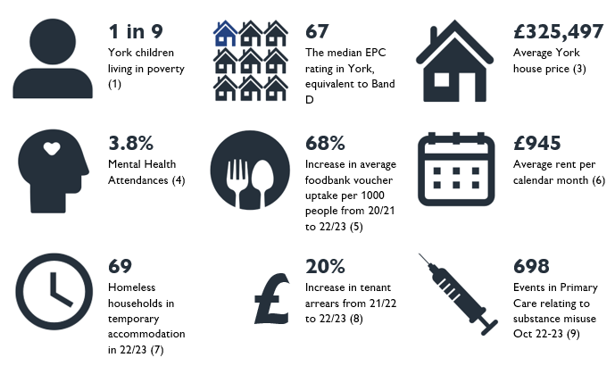
Key statistics
This dashboard brings together local health, social care, and housing data to help provide an overview of how rising prices could be having an impact on York's health.

Slide 24
Methodology
The London School of Economics (Roberts, 2023)(3) has declared the cost of living crisis as a “public health emergency”. The inability for some people to afford even the basic essentials can have far-reaching health consequences that impact on both mental and physical health. The infographic below shows the complexities of these consequences and highlights both the systemic and individual impacts.

Slide 25
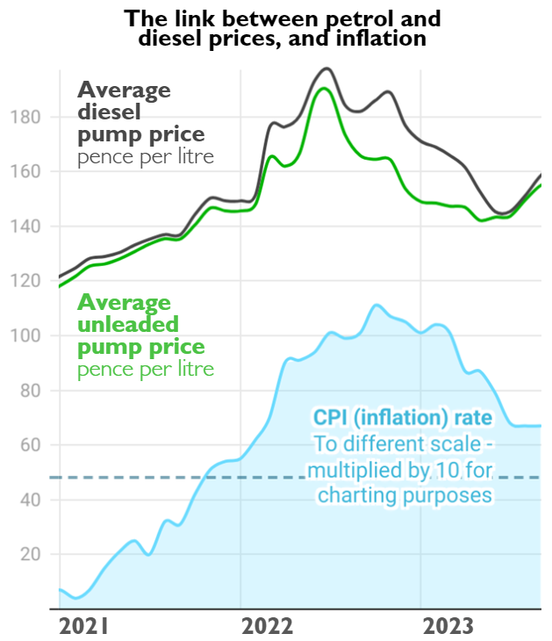
Fuel, Transport & Accessibility
16% of households in Yorkshire & Humber are experiencing fuel poverty. The national average is 15%
Source: Cost of Living Report, 2022
Key points distilled from report
Estimated Fuel Poverty by Ward

Slide 26
Housing Stability & Affordability
The voice of York's citizens
Money is not stretching as it used to, and people are having to having to use savings to pay bills.
People are begging landlords not to sell houses as they otherwise would not be able to afford the higher current rents.
People are struggling to heat their homes resulting in many cases of exacerbations of existing physical and/or mental health conditions.
Source: Healthwatch Cost of Living Report
Key points distilled from report
Homeless households in temporary accommodation in York
Current Tenant Arrears in York

Slide 27
Food accessibility & consumption
“I go to foodbanks now as food has gone up so much... nor do I often put my heating on.”
Increase in average uptake of foodbank vouchers of 20% in York
From 2019-2023
Source: York Foodbank
Key points distilled from report
Comparative voucher provision in 2021/22 & 2022/23

Slide 28
Household debt & disposable income
7 in 10 adults are spending less on non-essentials because of cost of living increases
Adults in Great Britain, 6 September to 17 September 2023
Source: Office for National Statistics
Key points distilled from report
Median earnings of residents (Gross Weekly Pay)

Slide 29
Energy Use
Around half of adults are using less fuel in their homes because of cost of living increases
Adults in Great Britain
Source: Office for National Statistics
Key points distilled from report

Slide 30
A&E Attendances and Admissions for Respiratory Conditions (April 2022 to March 2023)
Diagnosis of Asthma or COPD

Slide 31
A&E Attendances and Admissions for Respiratory Conditions (April 2022 to March 2023)
Diagnosis of Respiratory condition (Inc. Asthma, COPD, Bronchiectasis, Bronchitis)

Slide 32
York
Key points distilled from report

Slide 33
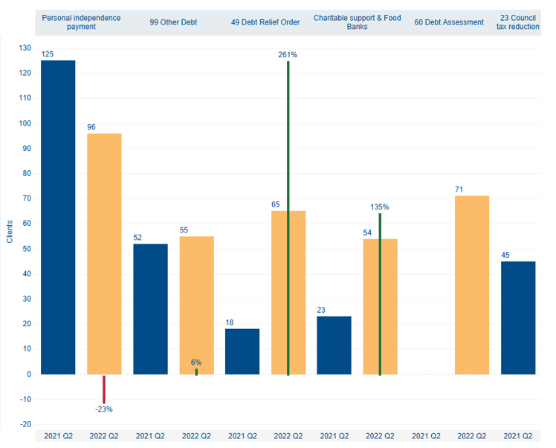
York
Key points distilled from report

Slide 34
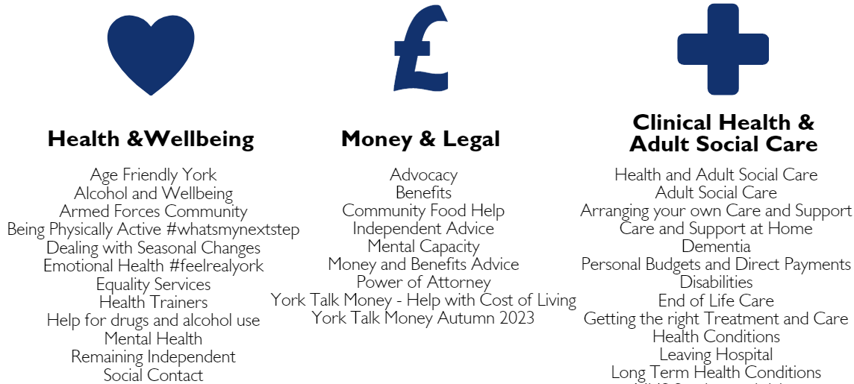
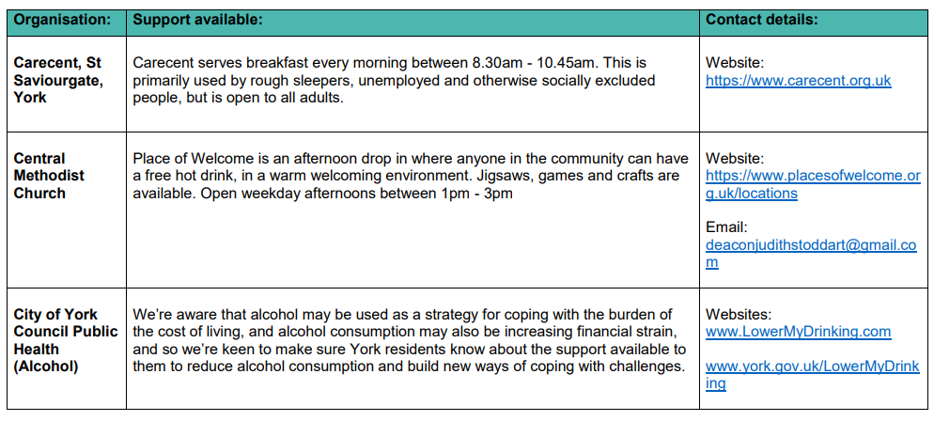

Slide 35
Official Statistics- Children in Low Income Families: Local Area Statistics, Financial Year ending 2022, Department of Work & Pensions Median Energy Efficiency Score, England and Wales, 1st November 2023 Land Registry House Price Statistics, York August 2022-August 2023 SUS ECDS Data – Mental Health related attendances include ED diagnosis of a Mental Health Condition, as well as several presenting complaints which relate to Mental health, and intentional self-harm injuries York Food Bank, April 2020-March 2021 (19.7 vouchers/1000 people) & April 2022-March 2023 (38.2 vouchers/1000 people) Quarterly Market Report, Zoopla, May 2022 CYC Cost of Living 2019-2023, Strategic Business Intelligence Hub, October 2023 April 2021-March 2022 (£1,342,660.34) & April 2022-March 2023 (£1,613,175.73) Primary care data(a), SystmOne, 31/10/22-31/10/23. Primary care data(a), SystmOne, 01/01/23-31/08/23. Primary care data(a), SystmOne, snapshot as of 24/10/2023, IMD 1-3 (average ACT score 20.6) & IMD 4-10 (average ACT score 21.7), 6-18 years old, QoF 2023 register (b) Primary care data(a), SystmOne, August 2021 (26 patients) & August 2023 (44 patients). Citizen's Advice York, April 2023-September 2023, disabled (8%), long term health condition (47%) Primary care data(a), SystmOne, snapshot as of 24/10/2023, 6-18 years old, QoF 2023 register (b) Primary care data(a), SystmOne, snapshot as of 09/11/2023, QoF 2023 register (b) Warm Spaces site: www.warmspaces.org Primary care data(a), SystmOne, January-March 2022 (140 patients) & January-March 2023 (177 patients) Primary care data(a), SystmOne, snapshot as of 09/11/2023, current diagnosis of Depression, Anxiety, Eating Disorders, and/or Severe Mental Illness, IMD 1-3 Primary care data extracted from SystmOne includes GP practices: Dalton Terrace Surgery, Front Street Surgery, Haxby Group Practice, Jorvik Gillygate Practice, MyHealth, Old School Medical Practice, Priory Medical Group, and York Medical Group. Only residents living within the City of York council local authority boundary have been included, unless otherwise stated. Data pertaining to the Quality Outcomes Framework (QOF) clinical domain includes the following disease registers: Atrial Fibrillation, Coronary Heart Disease, Heart Failure, Hypertension, Peripheral arterial disease, Stroke & TIA, Diabetes, Asthma, COPD, Dementia, Depression, Severe mental illnesses, Chronic kidney disease, Epilepsy, Osteoporosis, and Rheumatoid arthritis.
Appendix

Slide 36
Thank you for listening.
Questions for discussion:
Based on the information/data presented, how will this impact your current projects/work? What will you take away into your daily role?
In your day-to-day work, are you aware of any specific groups experiencing challenges in accessing health and care due to financial constraints?

