Slide 1
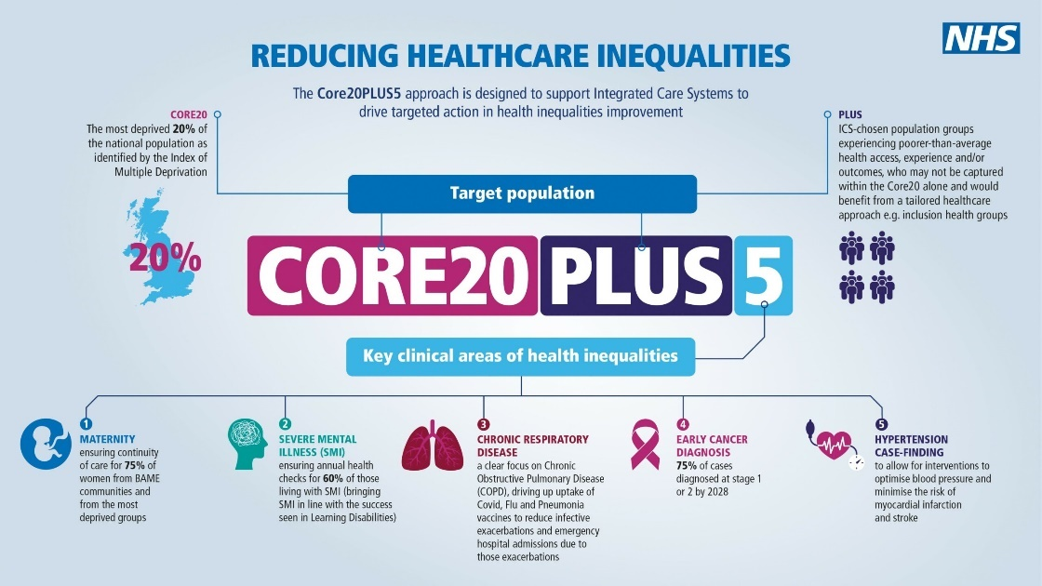
In York ‘Place’ of Humber and North Yorkshire ICB

Slide 2
Background
  The Kings Fund has defined health inequalities as:
'avoidable, unfair and systematic differences in health between different groups of people.' (Kings Fund 2021)
Recent high-profile work by Professor Michael Marmot at the UCL institute of Health Equity suggesting that the 2010s were, nationally, a ‘lost decade’ in which life expectancy improvement stalled, and in the more deprived deciles of the population life expectancy declined for the first time in generations, further widening the inequalities gap in society.
Differences in health outcome between populations have complex causes and wide socio-economic drivers. Good quality and accesible healthcare services play a vital role in influencing these outcomes, although not perhaps as large a role as we might think (accounting for an estimated 15-40% of the overall determinants of a person's health (Kings Fund 2018)). Additionally, healthcare does not always reduce inequalities in health outcomes, and can often serve to exacerbate them, a phenomenon known as the 'Inverse Care Law’:
‘The desired product of healthcare systems is health gain… but the world over, the more any community needs good medical care, the less likely it is to receive it’ Julian Tudor Hart, The Political Economy of Health Care

Slide 3
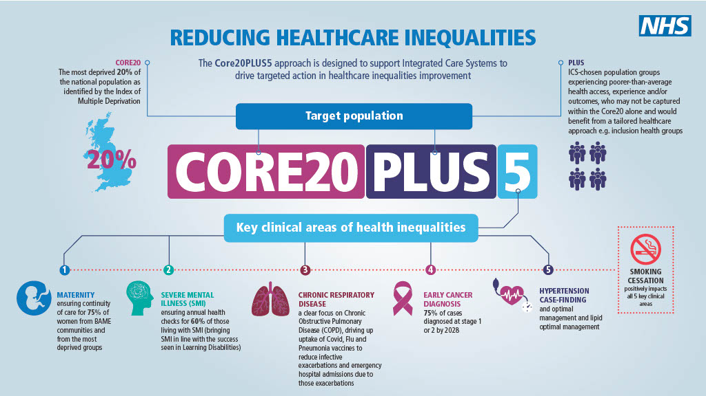
CORE20PLU5 is a national NHS England and Improvement initiative aimed at reducing health inequalities through the concerted efforts of the health and care system, both at a national, regional and local level.
The approach defines a target population cohort – the ‘Core20PLUS’ – and identifies ‘5’ focus clinical areas requiring accelerated improvement.
This slideset aims to quantify who the CORE20PLUS5 population is in York Place.

Slide 4

This refers to those living in the 20% most deprived small areas (LSOAs), defined by the 2019 Index of Multiple Deprivation.
York has 9,711 people (4.6% of the population) who live in LSOAs which are amongst the 20% most deprived in England. Of these, 1,680 people (0.8% of the population) live in an area which is among the 10% most deprived in England.
The map overleaf presents these areas, which are within three of York's wards
It should be noted that the Index of Multiple Deprivation is a composite measure of seven distinct domains (Income, Employment, Health, Education, Crime, Housing/services and Living Environment) and some areas may have high needs / levels of deprivation in one domain which are 'masked' by lower scores across all domains. Additionally, IMD is an ecological measure: that is, the average score for an area cannot be assumed to apply to all individuals living in that area.

Slide 6
This refers to specific population groups spread out across geographies who can experience particular health needs or inequalities. In York we have identified a number of ‘Plus’ groups, although this is by no means an exhaustive list:
ethnic minority communities: in York, the 2011 census showed that 5.7% of our population are from a Black or minority ethnic group, over 12,000 people, and this figure is likely to have risen since census data was collected. The most common ethnicities in York other than 'White British' include our Chinese population, those who responded 'other white', and those from Indian and 'other Asian' backgrounds.
people with multi-morbidities: in 2020 a health needs assessment for York found that nearly 11% of people registered with general practice in York have more than one long term condition
people experiencing homelessness: in York the most recent data shows that an average of 47 households were in temporary accommodation across 2020/21, and 803 households were owed a duty under the homelessness reduction act
drug and alcohol dependence: in 2020/21 there were 469 people in treatment for opiate dependence in York, 54 for non-opiate dependency, and 275 for alcohol dependence. Particularly with alcohol, this is likely to be a large underestimate of the true need for dependency treatment in the city

Slide 7
cont’d
vulnerable migrants: including those in the UK as asylum seekers and with refugee status, where numbers are hard to estimate but are likely to be increasing as the city works within its City of Sanctuary status to welcome recent arrivals from Syria, Afghanistan and Ukraine. Up to date information on the number of migrants in York from these three areas is available from CYC
gypsy, Roma and Traveller communities: The York Gypsy, Roma and Traveller Strategy 2013- 2018 identifies that there are approximately 350 Gypsy and Traveller families in York, living on traveller sites, houses and on the roadside. A Gypsy and Traveller Health Needs Assessment is currently being undertaken by York Public Health team.
sex workers: where numbers in York are again hard to estimate, but clear evidence exists to show high levels of health need and issues accessing healthcare services, together with risks around exploitation, violence and trafficking.
students: there are currently over 30,000 students in York during term time, over 10% of our population. Whilst they are often healthier than the general population due to their younger average age, students experience a number of access and health outcome issues including higher levels of mental health need and higher likelihood of injury / trauma
More information on many of the above groups can be found on the York JSNA website

Slide 8
This refers to five key clinical areas which have been identified for targeted work on reducing inequalities:
Maternity, specifically the equitable provision of continuity of care to mums from ethnic minority backgrounds
In York there is no data currently which currently analyses maternity continuity of care by local authority and ethnic group, however as part of the NHSE Health Inequalities and Improvement Dashboard which is being developed this should become available
Severe Mental Illness, specifically bringing the proportion of the population with severe mental illness who receive an annual healthcheck up to 60%
In York this indicator has typically been around a quarter of the SMI population, however across the Vale of York CCG in the most recent quarter (Q4 2021/22) practices achieved 58.8% which is the highest ever performance achieved by some margin, 17.3% higher than the previous best (Q3 at 41.5%).
Chronic respiratory diseases, specifically increasing uptake of COVID-19 and Flu vaccination to prevent unplanned hospital admission
In York in 2020/21 27,714 people in were eligible for a flu vaccine due to underlying health conditions, and 14,938 people were vaccinated, 53.9% of the eligible population (under the 55% target)
Early cancer diagnosis, 75% of cases diagnosed at stage 1 or 2 by 2028
In the Vale of York CCG area, in 2019 53% of cancers were diagnosed at stage 1 or 2, lower than the national average of 54.6%. The percentage of cancers diagnosed early has declined in recent years due to the COVID-19 pandemic
Hypertension Case-Finding and optimal lipids: to allow for interventions to optimise BP and minimise the risk of myocardial infarction and stroke
In York there is a diagnosis gap for hypertension: currently only 60.5% of the estimated hypertensive population are diagnosed, below the regional and England average: this equates to around 15,950 people. The national ambition is for 80% of the expected number of people with hypertension to be diagnosed by 2029.
[Smoking cessation runs through our approach to all of these areas. There are over 20,000 smokers in York, over 1 in 10 of the population]

